Slide 1
Welding (cont.)

Slide 2
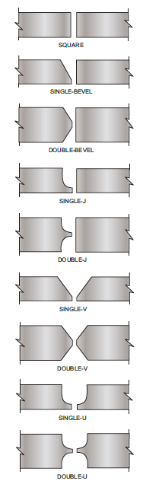
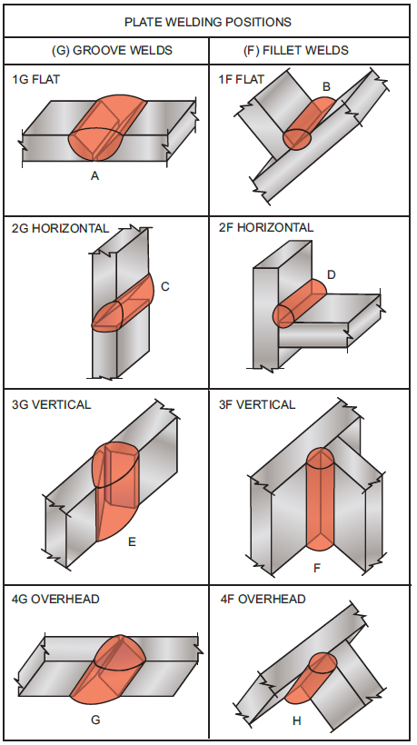
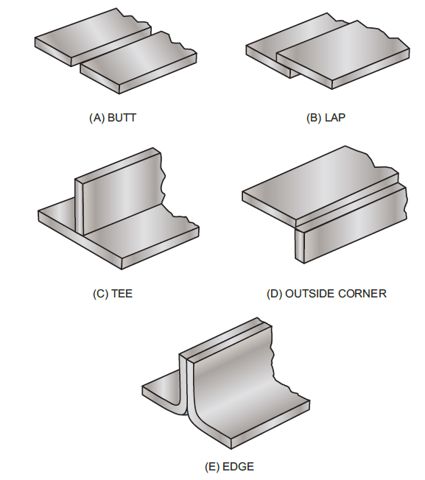
Weld Joints and positions

Slide 3
Welding defects
Various types:
Undercut
Underfill
Misalignment
Concavity/convexity
Excessive reinforcement
Overlap
Burn-through
Insufficient or incomplete penetration
Incomplete fusion
Arc strikes
Inclusion
Cracks

Slide 4
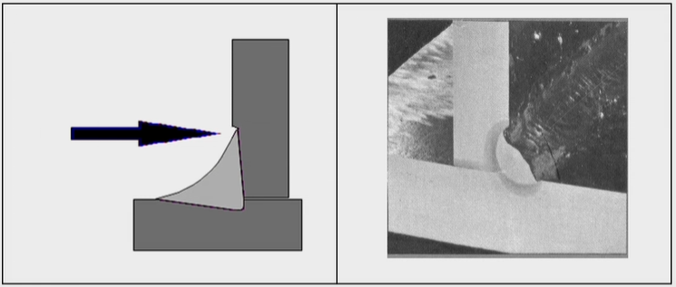
Undercut
It is a groove cut at the toe of the weld and left unfilled.
Cause: Due to high welding current, long arc length, rust.
Repair: weld with smaller electrode, preheat.
Note: undercut typically has an allowable limit (plate: 5% of thickness).

Slide 5
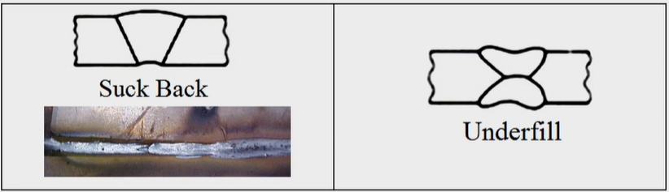
Insufficient fill
The weld surface is below the adjacent surface of the work piece material.
Cause: improper welding techniques, improper parameters
Prevention: apply proper welding techniques, weld type and position
Repair: simply weld to fill. May require preparation by grinding

Slide 6
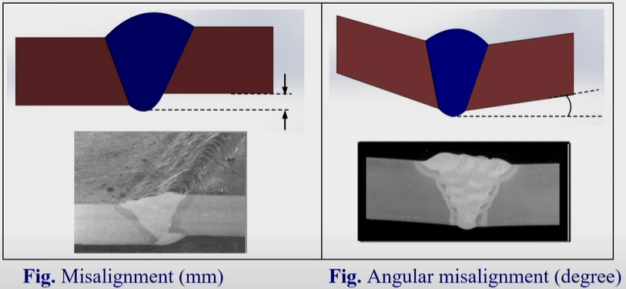
Misalignment
Out of the alignment at the root.
Cause: carelessness, joining of different thickness
Repair: Grinding operation
Note: difficult to repair for inside the pipe/tube

Slide 7
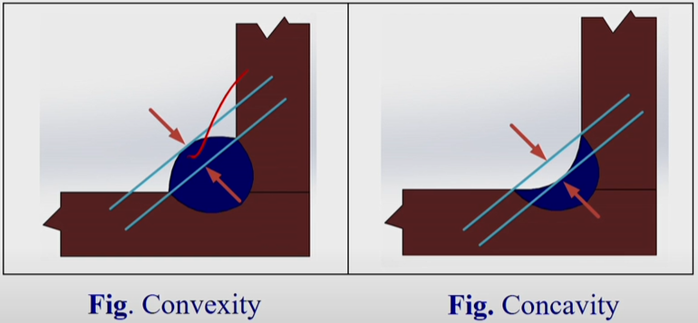
Excessive Concavity/convexity
Concavity or convexity of a fillet weld which exceeds the specified allowable limits.
Cause: Mainly due to welding current and travel speed.
Prevention: use proper welding parameters and techniques.
Repair: Grinding off or weld on.

Slide 8
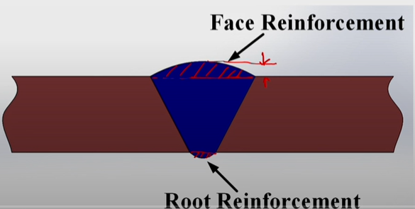
Reinforcement
Amount of groove weld which extends beyond the surface of the plate.
Types: Excessive, insufficient

Slide 9
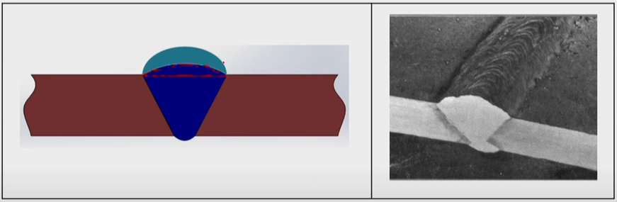
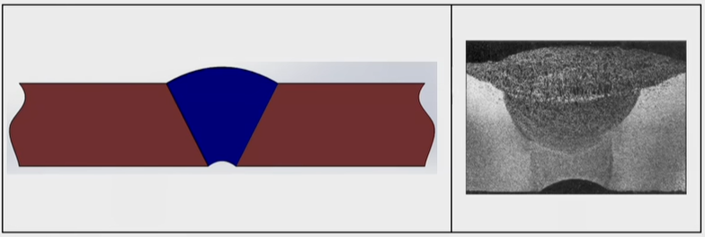
Reinforcement (cont.)
Excessive:
travel speed too slow, current too low
Proper welding current, travel speed
Insufficient:
Too little filler material will cause thinning of the filler material
Use proper technique

Slide 10
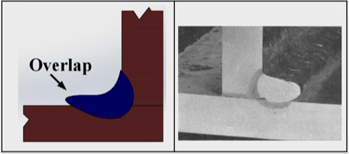
Overlap
When the face of the weld extents beyond the toe of the weld.
Improper welding technique and travel speed.
Use proper technique.
It must be removed to blend smoothly into the base metal.

Slide 11
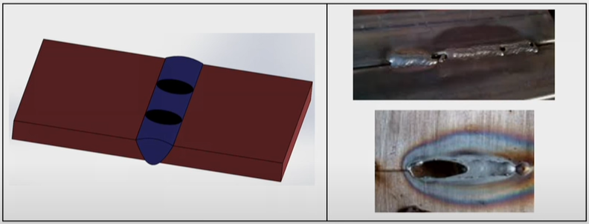
Burn through
An undesirable open hole has been completely melted through the base metal.
Excessive welding current and excessive heat input
Reduce heat input by increasing welding travel speed

Slide 12
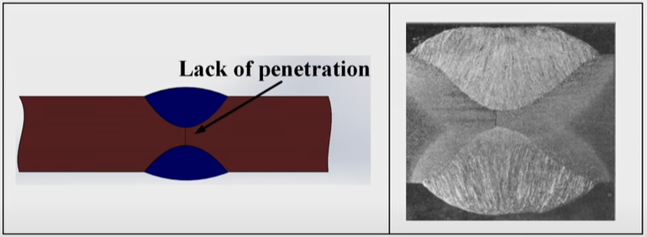
Insufficient and incomplete penetration
When the weld metal does not extend to the required depth into the joint root.
Low welding current, insufficient root opening, short arc length, high travel speed.
Correct the contributing parameters.

Slide 13
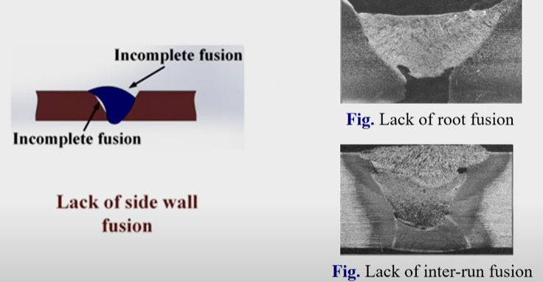
Incomplete fusion
When the weld metal does not form a cohesive bond with parent metal.
Due to low current, fast travel speed, short arc gap, unclean base metal, lack of preheat.
Remove and correct the potential causes.

Slide 14
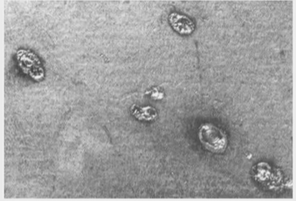
Arc strikes
It is a localized coalescence outside the weld zone.
Carelessness, lack of experience.
In adjacent area can be protected using fire blankets.

Slide 15
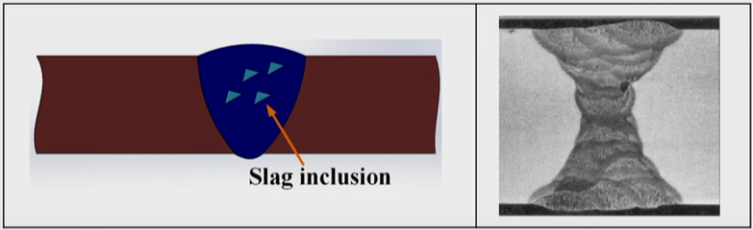
Inclusion
Tungsten/slag
Slag inclusion: slag entrapped within weld.
Mainly due to low current.
Increase weld current and preheat.

Slide 16
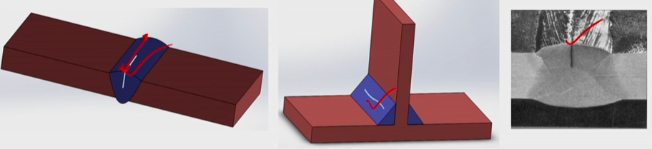
Cracks
Longitudinal
Mainly due to fast cooling of weld joint. Also caused by shrinkage stresses in high constraint areas.
Weld towards areas of less constraint. Also preheat it.

Slide 17
Solid State Welding
In solid state-welding, coalescence of the part surfaces is achieved by (1) pressure alone, or (2) heat and pressure.
If both heat and pressure are used, the amount of heat by itself is not sufficient to cause melting of the work surfaces.
In most of the solid-state processes, a metallurgical bond is created with little or no melting of the base metals.
To metallurgically bond two similar or dissimilar metals, the two metals must be brought into intimate contact so that their cohesive atomic forces attract each other.
In solid-state welding, the films and other contaminants must be removed by other means to allow metallurgical bonding to take place.

Slide 18
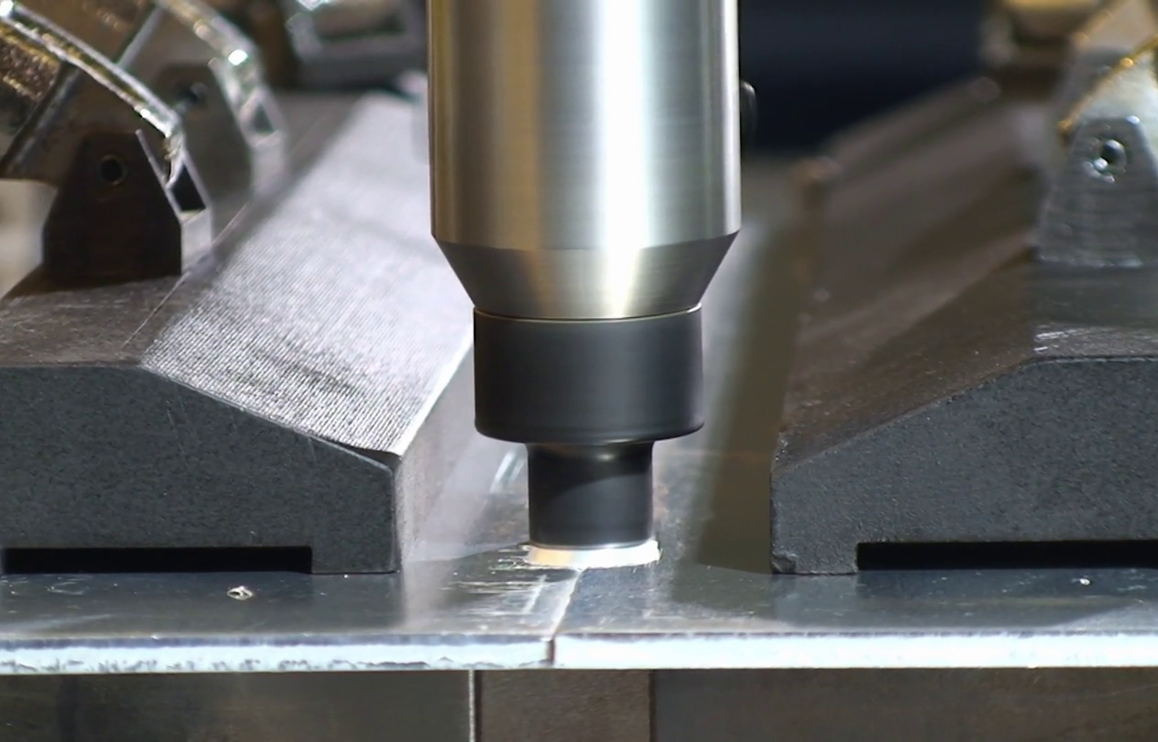
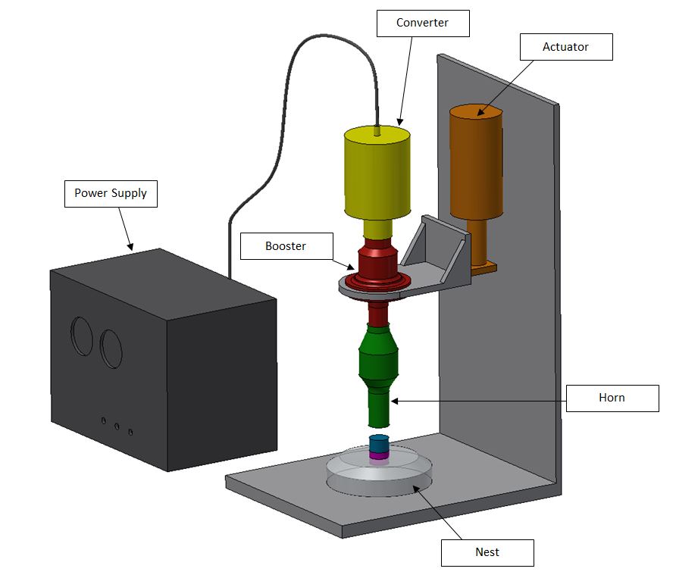
Solid State Welding
Friction Stir welding
Ultrasonic Welding

Slide 19
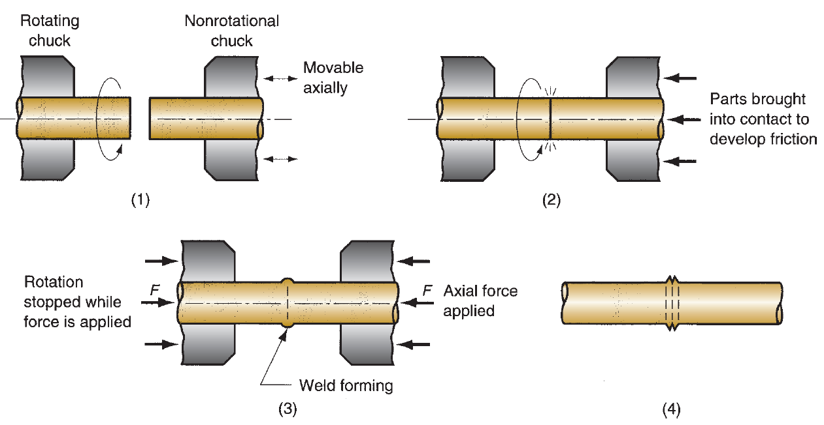
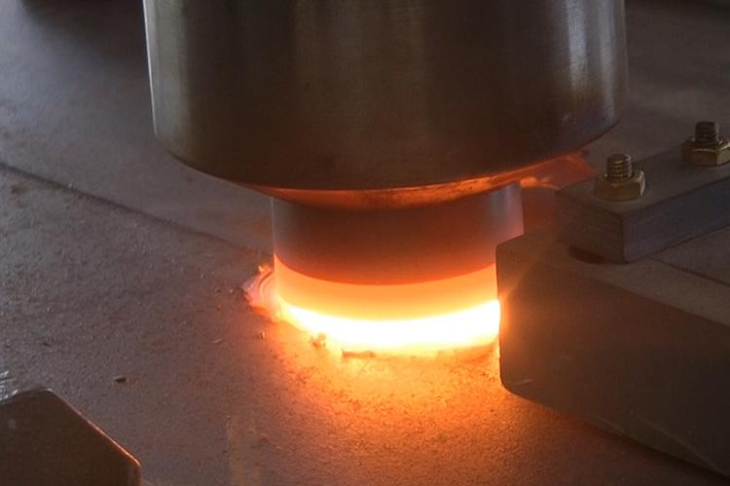
Friction stir welding (FSW)
Developed in the (former) Soviet Union and introduced into the United States around 1960.
Friction welding (FRW) is a solid-state welding process in which coalescence is achieved by frictional.
The friction is induced by mechanical rubbing between the two surfaces, usually by rotation of one part relative to the other, to raise the temperature at the joint interface to the hot working range for the metals involved.
Then the parts are driven toward each other with sufficient force to form a metallurgical bond.
The axial compression force upsets the parts, and a flash is produced by the material displaced.

Slide 20
Applications
The process is primarily used in industry to join aluminium alloys of all grades, whether cast, rolled or extruded.
FSW has been shown to weld aluminium alloy butt joints with a thickness of between 0.3mm and 75mm in a single pass, depending on the alloy grade and capability of the FSW machine.
FSW has been used for a variety of applications across industries ranging from aerospace to shipbuilding and rail to electronics, including EV battery trays.
Other materials that have been joined with FSW include magnesium, titanium, copper, nickel and steel alloys, while plastics and metal matrix composites (MMC) have also been explored.
This process has also been shown to be able to join dissimilar combinations of these materials including aluminium to steel.

Slide 21
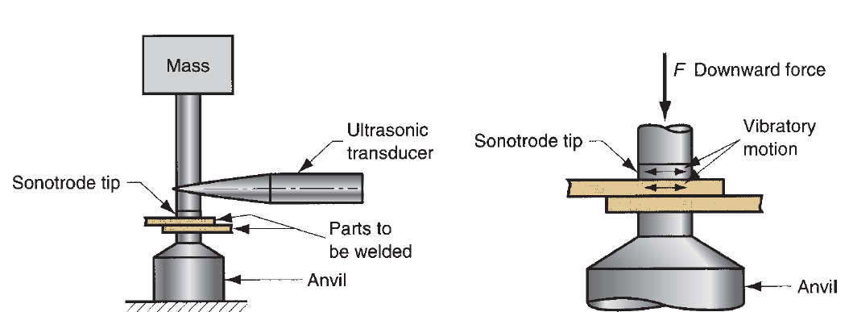
Ultrasonic Welding
Two components are held together under modest clamping force, and oscillatory shear stresses of ultrasonic frequency are applied to the interface to cause coalescence.
The oscillatory motion between the two parts breaks down any surface films to allow intimate contact and strong metallurgical bonding between the surfaces.
The oscillatory motion is transmitted to the upper work part by means of a sonotrode, which is coupled to an ultrasonic transducer.
This device converts electrical power into high-frequency vibratory motion.
Typical frequencies used in USW are 15 to 75 kHz, with amplitudes of 0.018 to 0.13 mm (0.0007–0.005 in).

Slide 22
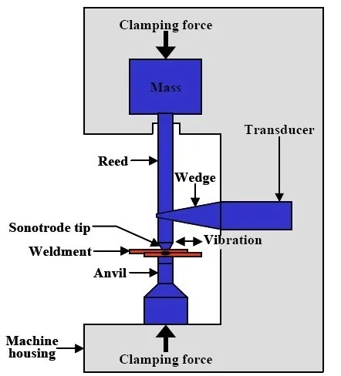
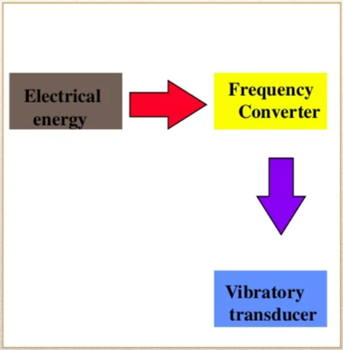
Ultrasonic Welding Process
High frequency ultrasonic acoustic vibrations are locally applied to work pieces being held together under pressure to create solid state weld.
Frequency is transformed to vibrational energy through transducer.
Energy requirement established through empirical relationship
E = K(HT)^3/2
E-electrical energy (J)
H- Vickers hardness number
T -thickness of the sheet
USW operations are generally limited to lap joints on soft materials such as aluminum and copper.

